Slide 1
Fraud Transaction Detection

Slide 2
Objective:
Development of a predictive model for monitoring fraud transaction detection to predict the transaction is correct or fraud I n banking and other online transactions. The model will determine whether a transaction is fraud or not.
Benefits:
Whether the completed transaction is fraud or not.
Digitalization is one of the major advancements we have in this time. The global market is at the fingertip of each and every individual through Online purchase to detect fraud transaction.
Improve healthy relationship between customers and retailers.

Slide 3
Data Sharing Agreement :
Sample file name (ex fraudDetection_20062021_101010)
Length of date stamp(8 digits)
Length of time stamp(6 digits)
Number of Columns
Column names
Column data type

Slide 4
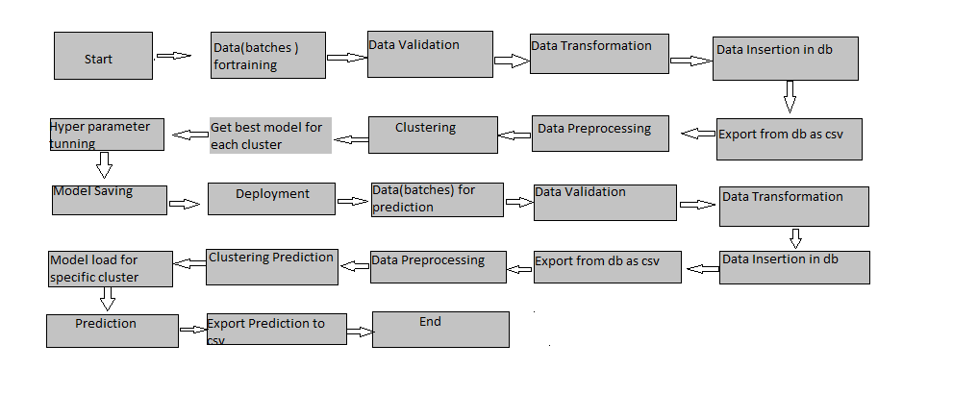
Architecture

Slide 5
Data Validation and Data Transformation :
Name Validation - Validation of files name as per the DSA. We have created a regex pattern for validation. After it checks for date format and time format if these requirements are satisfied, we move such files to “table" else “report .yaml file“
Number of Columns – Validation of number of columns present in the files, and if it doesn't match then the file is moved to “report.yaml file.“
Name of Columns - The name of the columns is validated and should be the same as given in the schema file. If not, then the file is moved to “report.yaml file".
Data type of columns - The data type of columns is given in the schema file. It is validated when we insert the files into Database. If the datatype is wrong, then the file is moved to “Report.yaml file".
Null values in columns - If any of the columns in a file have all the values as NULL or missing, we discard such a file and move it to "Bad_Data_Folder".

Slide 6
Data Insertion in Database:
Data base name :- Data base name “fraud_detection" is created in the database for inserting tables into data base
Table name or collection name: Created one collection name as predicting fraud and inserting files
Inserting files- All the files are inserted in the above-created table. If any file has invalid data type in any of the columns, the file is not loaded in the table

Slide 7
Model Training:
Data Export from Db :
The accumulated data from db is exported in csv format for model training
Data Preprocessing
Performing EDA to get insight of data like identifying distribution , outliers ,trend
among data etc.
Check for null values in the columns. If present impute the null values.
Creating new features from existing features .
From Existing customer_id and tx_amount creating three new features , using terminal id creating Three new features.
Some feature engineering operations like creating features like transaction is done in week or weekend and is transactions done in day time or morning time .
A person average transaction with in a day ,week and with in a month.
From existing features there are no relation ship between features so , model build but give very low test accuracy which is overfit model
So From existing features creating 8 more features to build a good model, and droping existing feature we get a very good model with good train and test accuracy.

Slide 8
Model Selection –
After Performing data preprocessing , we find the best model for data By using 2 algorithms “DECISION TREE” ,"XGBoost” ,”LOGISTIC REGRESSION”, “SVM”. For data above the hyper tunned algorithms are used. We calculate the f1_score scores for all models and select the model with the best score. Similarly, the model is selected for each cluster. All the models for data are saved for use in prediction.
Among all above models Decision tree giving best train and test accuracy so Selects Decision tree for model building.

Slide 9
Prediction:
The testing files are shared in the batches and we perform the same Validation operations ,data transformation and data insertion on them.
The accumulated data from db is exported in csv format for prediction
We perform data pre-processing techniques on it.
Once the prediction is done for all the clusters. The predictions are saved in csv format and shared.

Slide 10
Q & A:
Q1) What’s the source of data?
The data for training is provided by ineuron , by giving a dataset link which is randomly generated data uploaded to a git hub repository
Q 2) What was the type of data?
The data was the combination of numerical and Categorical values.
Q 3) What’s the complete flow you followed in this Project?
Refer slide 5th for better Understanding
Q 4) After the File validation what you do with incompatible file or files which didn’t pass the validation?
Files like these are moved to the Achieve Folder and a list of these files has been
shared with the client and we removed the bad data folder.

Slide 11
Q 5) How logs are managed?
We are using different logs as per the steps that we follow in validation and
modeling like File validation log , Data Insertion ,Model Training log , prediction log
etc.
Q 6) What techniques were you using for data pre-processing?
Removing unwanted attributes
Visualizing relation of independent variables with each other and output variables
Checking and changing Distribution of continuous values
Cleaning data and imputing if null values are present.
Performing feature engineering like creating new features for existing feature for getting good model.

Slide 12
Q 7) How training was done or what models were used?
Before diving the data in training and validation set we performed EDA and Preprocessing of data
As per cluster the training and validation data were divided.
The scaling was performed over training and validation data
Algorithms like DECISION TREE, RANDOM FOREST ,LOGISTIC REGRESSION ,SVM , XGBoost were used based on the recall final model was used for each cluster and we saved that model .
Q 8) How Prediction was done?
The testing files are shared by the client .We Perform the same life cycle till the data is clustered .Then on the basis of cluster number model is loaded and perform prediction. In the end we get the accumulated data of predictions.

Slide 13
Q 9) What are the different stages of deployment?
Deploy into AWS using Airflow and Schedulers

